Slide 1


Slide 2
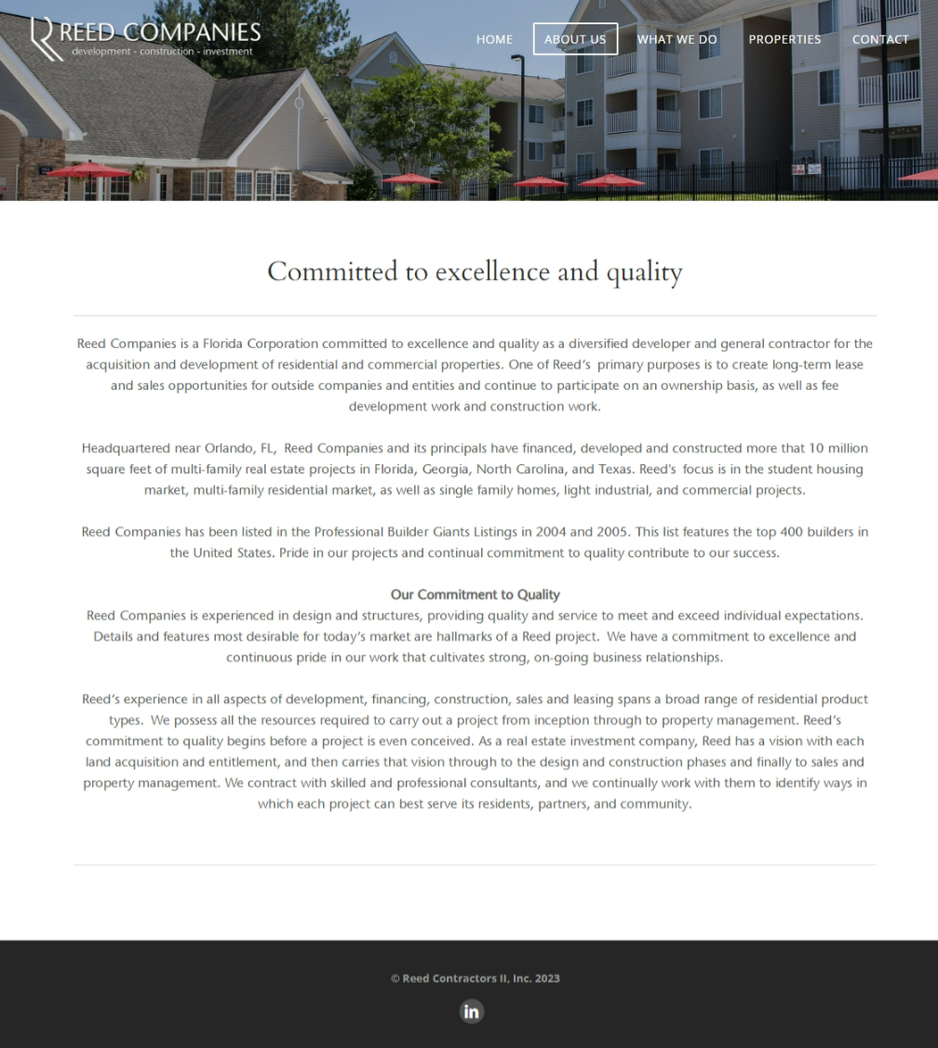

Slide 3
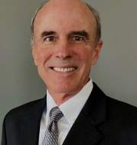
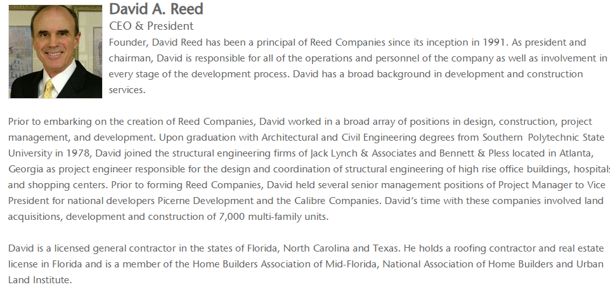

Slide 6
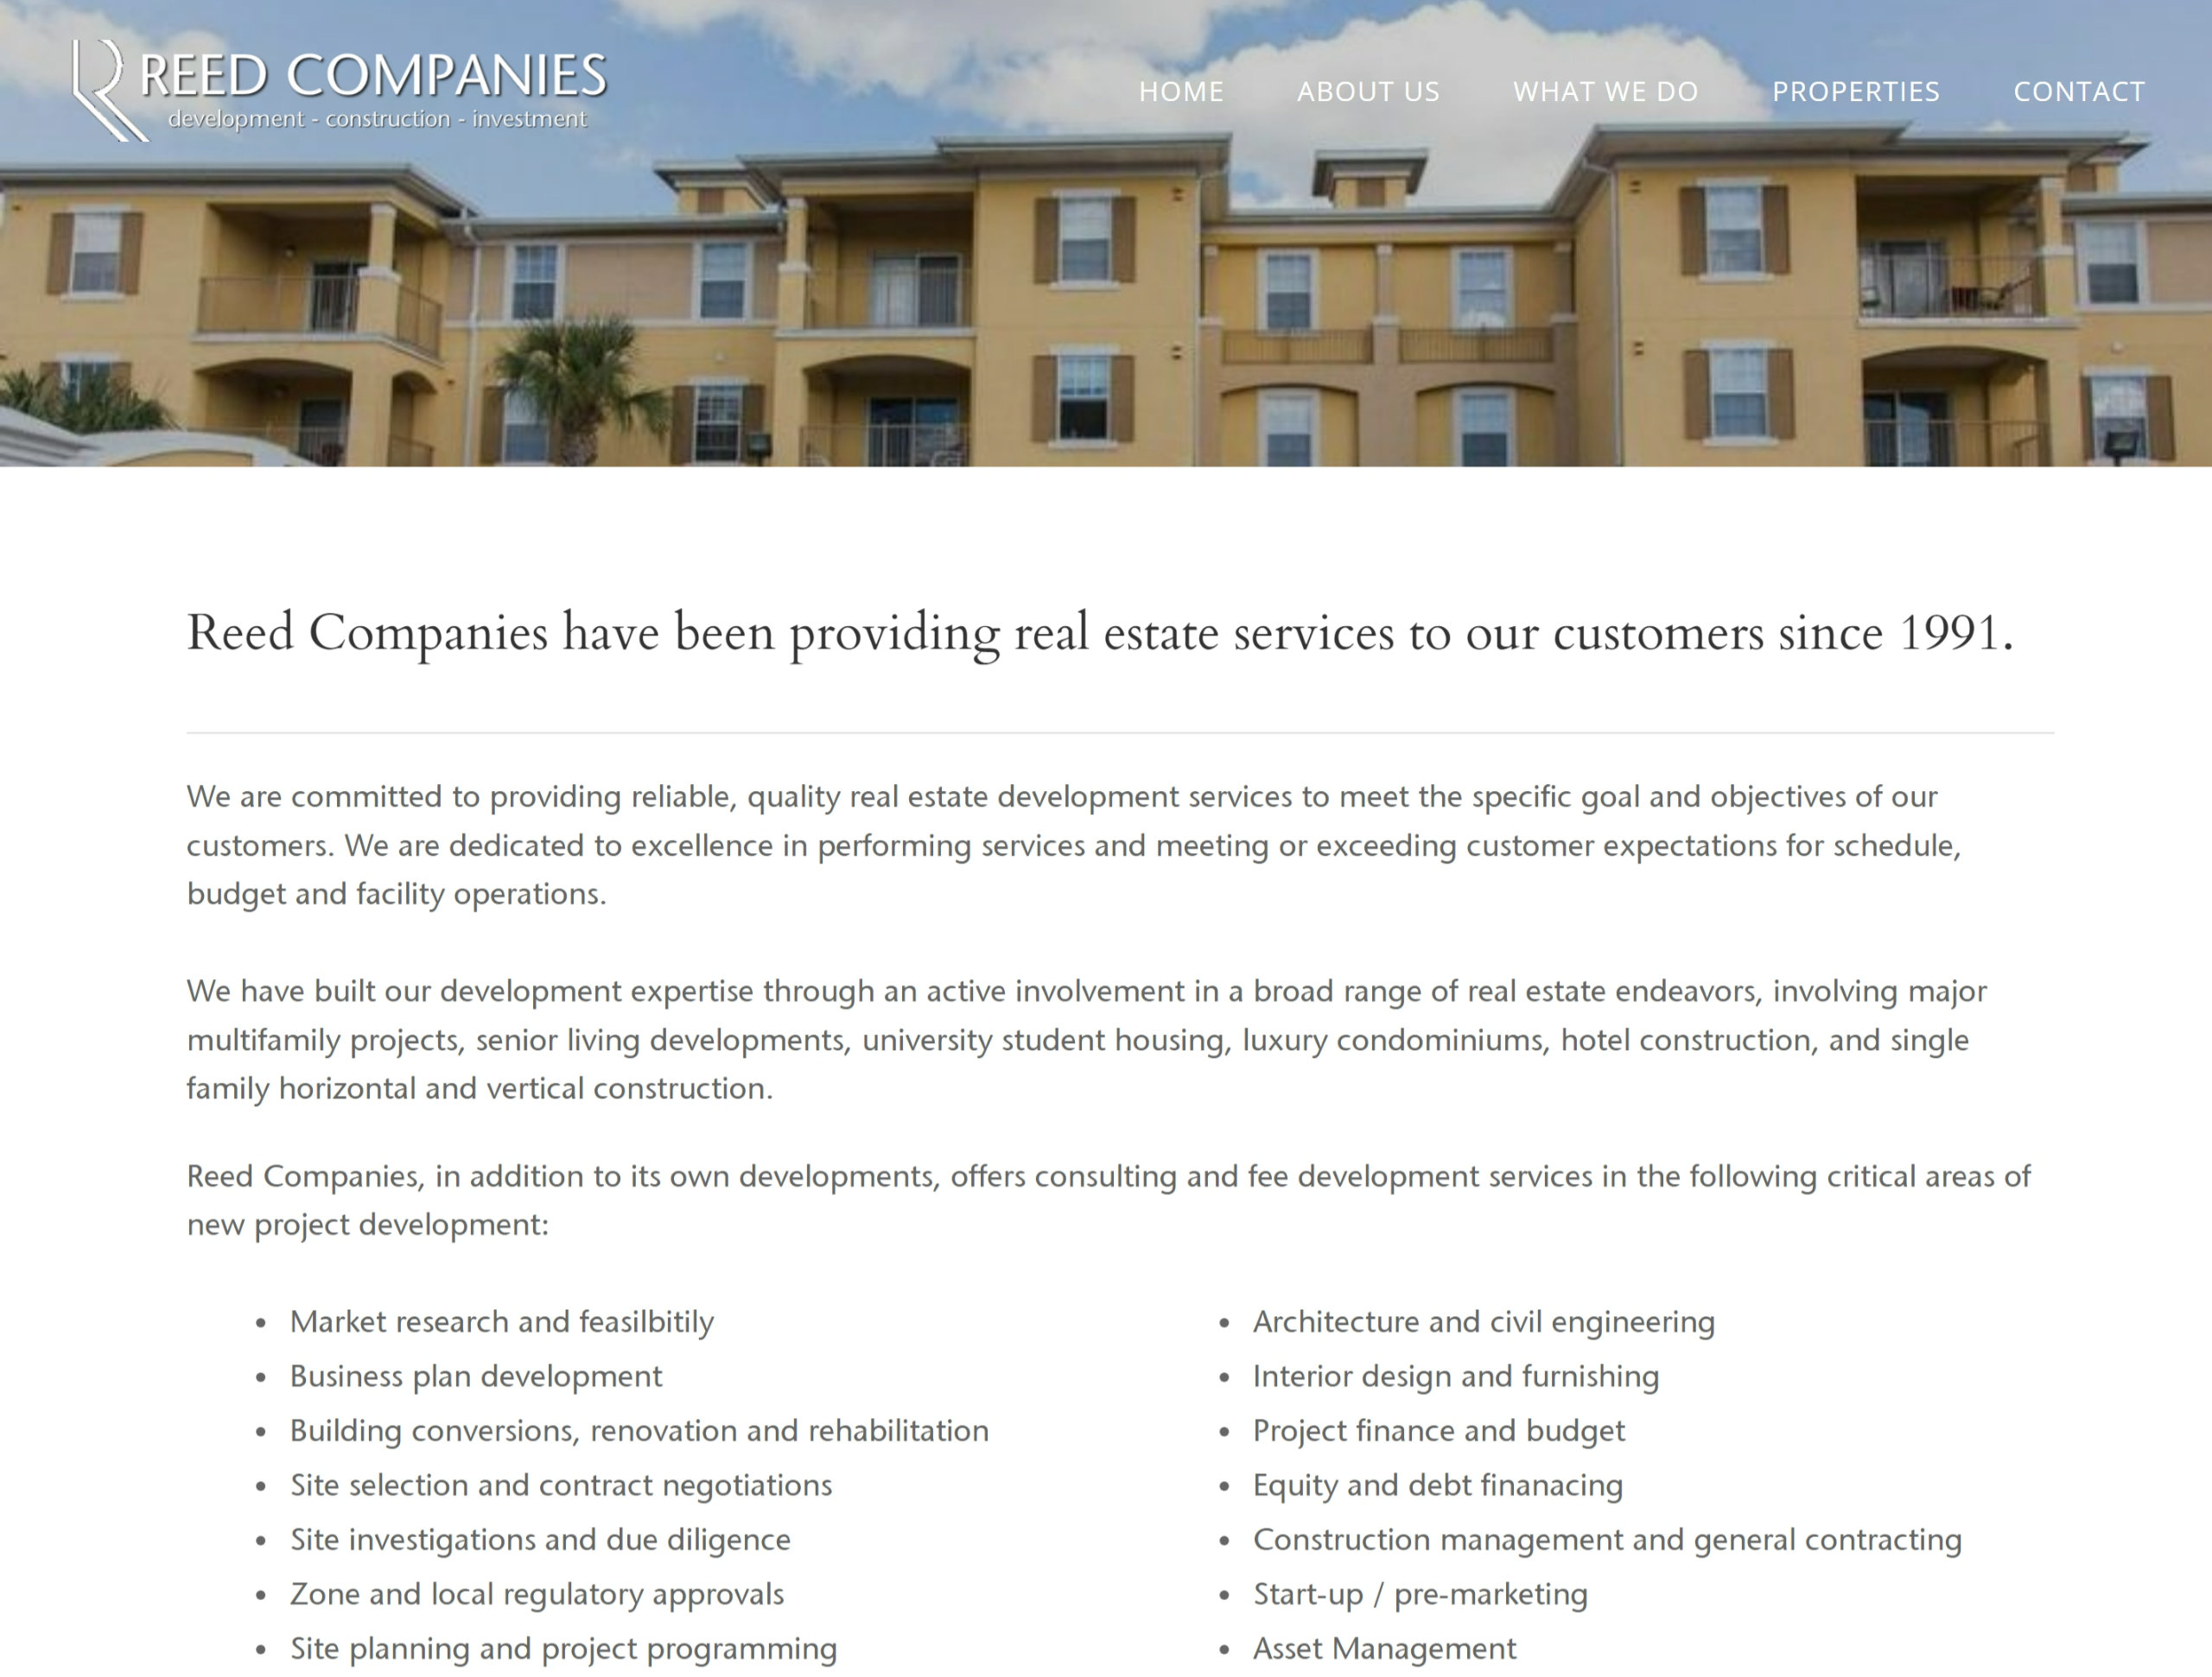

Slide 7
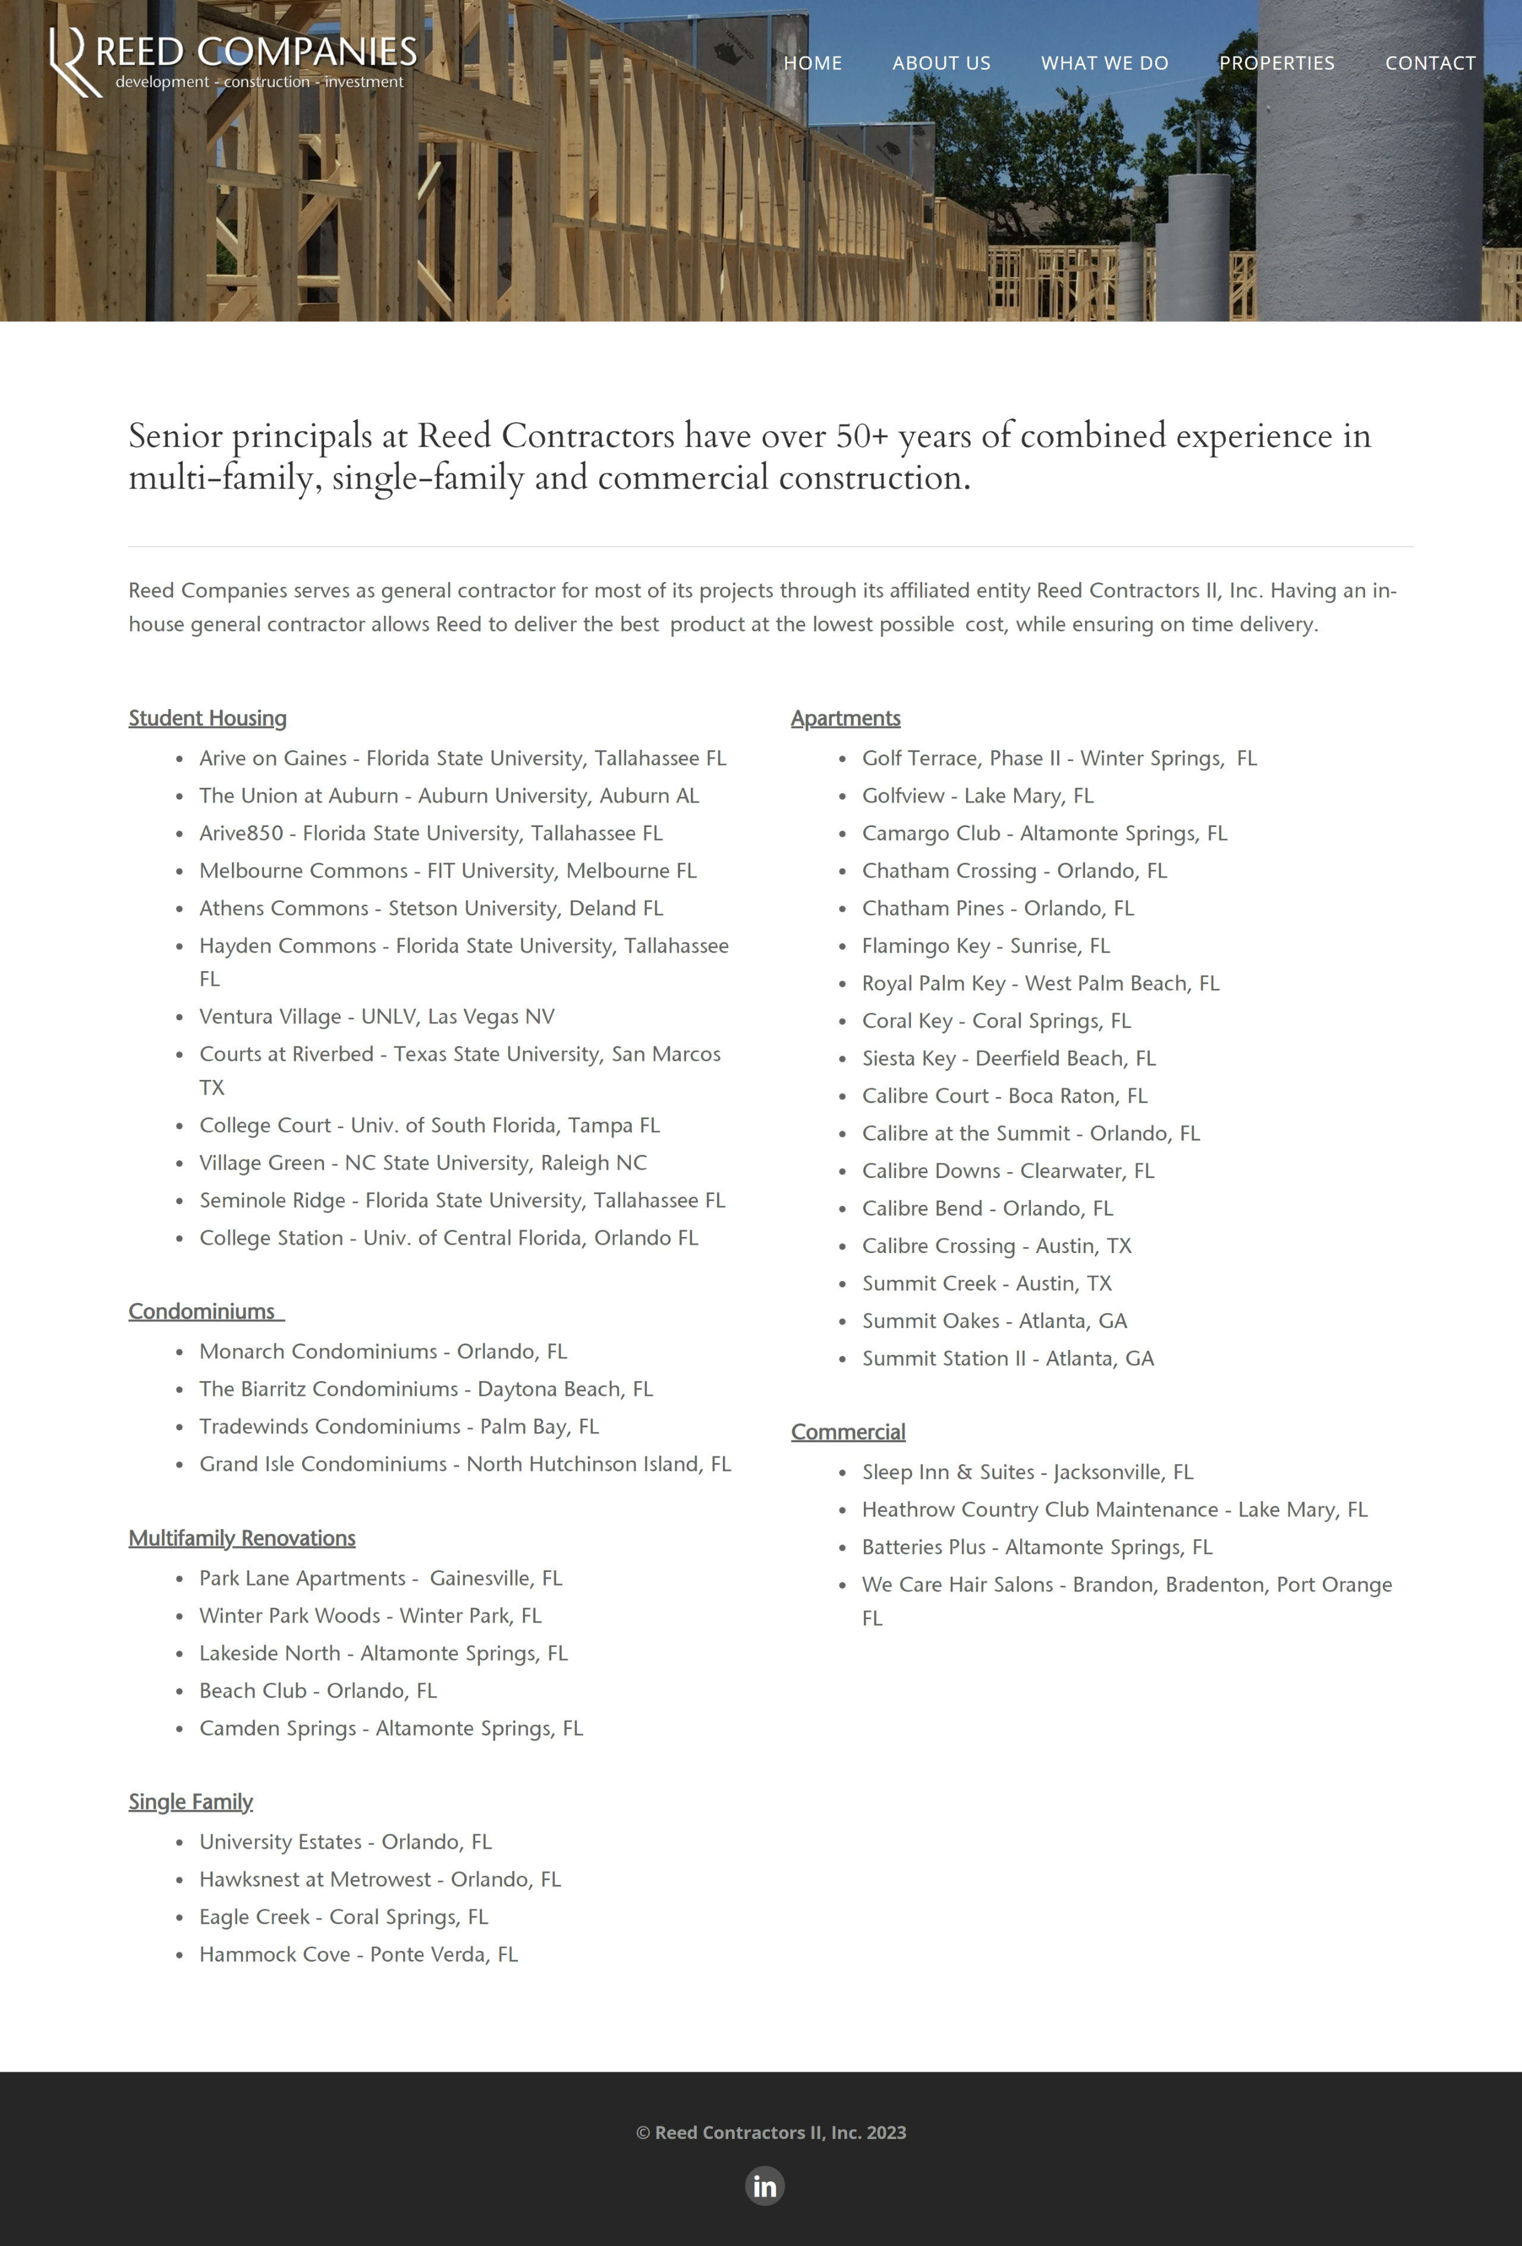

Slide 8
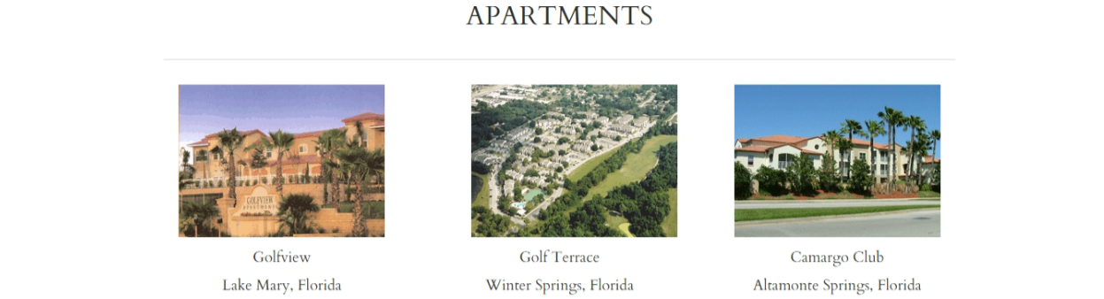
PROJECT LIST & DEAL SHEET
Community | Location | Units | Project Cost | Summary
Multifamily - New Construction
Mosby Twin Laurel Apartments | Nokomis, FL | 330 | $94,700,000 | 2022 - 2023 - Development - 4 story, elevator conditioned corridor market rate - Design, entitlements, rezoning, financial analysis
Hamlet Legacy Trail - BTR | Venice, FL | 260 | $91,830,000 | 2022 - 2023 - Build to Rent - Cottages, Duplexes & T.H.s - Pre-development, financial feasibility analysis, market analysis, permits
Hamlet Avalon - BTR | Wesley Chapel, FL | 260 | $79,100,000 | 2023 - Build to Rent - Cottages, Duplexes & T.H.s - Pre-development, building permits, financial feasibility analysis, market analysis
Mosby Avalon Apartments | Wesley Chapel, FL | 338 | $87,000,000 | 2023 - Present - Development - 4 story, elevator conditioned corridor market rate - Design, permits, CA, asset management
Mosby Citrus Ridge Apartments | Davenport, FL | 300 | $80,400,000 | 2022 - Present - Development - 4 story, conditioned corridor market rate apts - Development & CA, permits, asset management
Hamlet Wildlight - BTR | Yulee, FL | 250 | $72,000,000 | 2022 - Present - Build to Rent - Cottages, Duplexes & Townhomes - Development & CA, building permits, asset management.
The William - Univ. of Georgia | Athens, GA | 370 | $51,199,500 | 2019 - 2022 - Student Housing - Development & CM, land purchase, entitlements, site &building permits, asset management

Slide 9
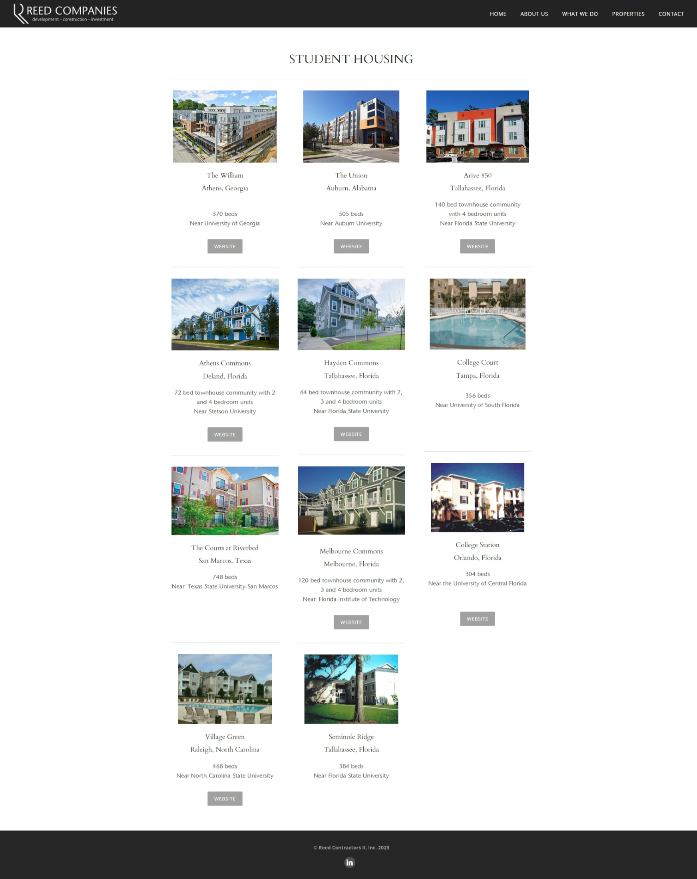
Community | Location | Units | Project Cost | Summary
The Union at Auburn | Auburn, AL | 505 | $52,503,000 | 2018 - 2020 - Student Housing - Development & CM, land purchase, entitlements, site &building permits, asset management
Arive 850 Apartments - FSU | Tallahassee, FL | 140 | $10,845,000 | 2017 - Student Housing - Construction & Development, land purchase, entitlements, site & building permits
Melbourne Commons - FIT Univ. | Melbourne, FL | 120 | $5,585,200 | 2016 - Student Housing - Construction - General Contractor
Stetson Commons - Stetson Univ. | Deland, FL | 72 | $3,239,200 | 2015 - Student Housing - Construction - General Contractor
Hayden Commons - FSU | Tallahassee, FL | 64 | $2,653,100 | 2015 - Student Housing -Construction - General Contractor
Weston Park Apartments | Longwood, FL | 202 | $19,930,000 | 2013 - 2014 - Development - TOD market rate & structured parking, design, entitlements, permitting
Casa Mirella Apartments | Ocoee, FL | 216 | $18,500,000 | 2013 - Construction, market rate, project management
Ventura Village - UNLV | Las Vegas, NV | 581 | $44,410,000 | 2014 - Student Housing - Development, financial feasibility analysis, equity & debt sourcing

Slide 10
Community | Location | Units | Project Cost | Summary
Courts at Riverbend - Texas State | San Marcos, TX | 748 | $29,500,000 | 2009 - Student Housing - Development, land purchase, entitlements, site & building permits
Monarch Condominiums | Orlando, FL | 179 | $78,900,000 | 2007 - Development - 24 story high-rise, in-fill site, entitlements, permits, marketing, sales, financing
The Biarritz Condominiums | Daytona Beach, FL | 100 | $26,100,000 | 2007 - Development - 15 story in-fill site, preliminary city planning and zoning approval
Tradewinds Condominiums | Palm Bay, FL | 160 | $41,091,000 | Development - Pre-development design, city planning, zoning and city council conditional use permit
Grand Isle Condominiums | N. Hutchinson Isl., FL | 49 | $24,000,000 | Construction & Development - G.C., 13 story beach front, design, permits, sales & marketing, condo docs
College Court - Univ. South FL | Tampa, FL | 356 | $10,250,000 | Student Housing - Construction & Development - G.C., land acquisition, planning, management, disposition
Village Green - NC State Univ. | Raleigh, NC | 468 | $13,900,000 | Student Housing - Construction, Development, G.C., land acquisition, planning, design, management, sale
Seminole Ridge - FSU | Tallahassee, FL | 384 | $10,400,000 | Student Housing - Construction, development, G.C., acquisition of unfinished project thru completion
College Station - Univ. Central FL | Orlando, FL | 304 | $8,500,000 | Student Housing - Construction, development, G.C., property management, disposition

Slide 11
Community | Location | Units | Project Cost | Summary
Golf Terrace - Phase II | Winter Springs, FL | 250 | $10,192,000 | Development, Construction of market rate apartments, design, permitting, general contractor
Golfview | Lake Mary, FL | 276 | $14,656,000 | Construction, market rate, general contractor
Camargo Club | Altamonte Spgs, FL | 252 | $9,636,800 | Construction, market rate, general contractor
Chatham Crossing | Orlando, FL | 320 | $7,888,000 | Construction, market rate apartments, general contractor
Chatham Pines | Orlando, FL | 208 | $5,127,000 | Construction, market rate apartments, general contractor
Flamingo Key | Sunrise, FL | 320 | $10,880,000 | Construction, market rate apartments, project management
Royal Palm Key | W. Palm Beach, FL | 400 | $11,560,000 | Construction, market rate apartments, project management
Coral Key | Coral Springs, FL | 364 | $10,520,000 | Construction, market rate apartments, project management
Siesta Key | Deerfield Beach, FL | 280 | $8,092,000 | Construction, market rate apartments, project management

Slide 12
Community | Location | Units | Project Cost | Summary
Calibre Court | Boca Raton, FL | 190 | $6,840,000 | Construction, market rate apartments, Director of Construction, general contractor
Calibre at the Summit | Orlando, FL | 480 | $12,288,000 | Development, market rate apartments, site plan approval, permitting
Calibre Downs | Clearwater, FL | 250 | $8,000,000 | Construction, market rate apartments, Director of Construction, general contractor
Calibre Bend | Orlando, FL | 212 | $7,208,000 | Construction, market rate apartments, Director of Construction
Calibre Crossing | Austin, TX | 183 | $4,511,000 | Construction & Development - market rate apartment, design, entitlements, permitting
Summit Creek | Austin, TX | 164 | $4,042,000 | Construction & Development - market rate apartment, design, entitlements, permitting
Summit Oakes | Atlanta, GA | 296 | $9,472,000 | Construction, market rate apartments, project management
Summit Station II | Atlanta, GA | 120 | $3,840,000 | Construction, market rate apartments, project management
TOTAL NEW MF |  | 11,321 | $1,101,288,800

Slide 13
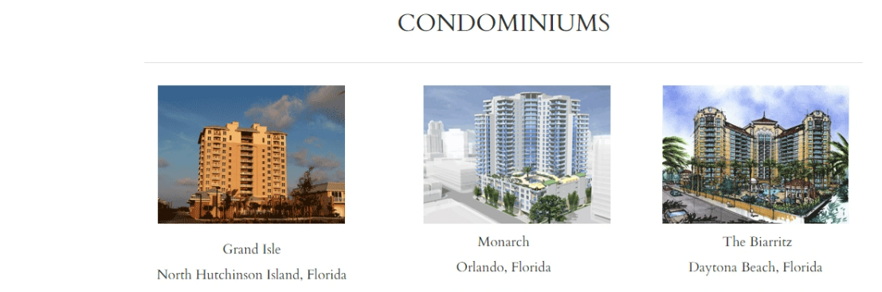
Multifamily Renovations
Park Lane Apartments | Gainesville, FL | 228 | $450,675 | 2013 - 2014 Construction - exterior renovation and structural repairs
Winter Park Woods | Winter Park, FL | 348 | $863,600 | Construction - general contractor for exterior rehabilitation
Lakeside North | Altamonte Spgs, FL | 480 | $407,200 | Construction - general contractor for exterior rehabilitation
Beach Club | Orlando, FL | 183 | $700,000 | Construction - general contractor for interior and exterior rehabilitation
Camden Springs | Altamonte Spgs, FL | 436 | $425,000 | Construction - general contractor for exterior rehabilitation
TOTAL RENOVATIONS |  | 1,675 | $2,846,475

Slide 14
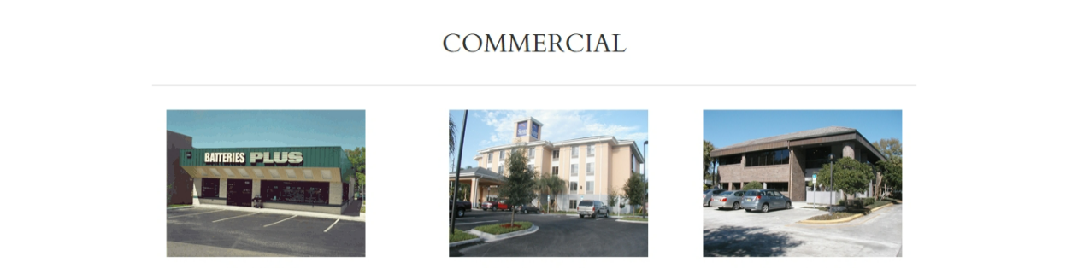
Commercial
Sleep Inn & Suites | Jacksonville, FL | 80 | $3,065,448 | Construction - General Contractor
Heathrow C.C. Maintenance | Lake Mary, FL | 1 | $278,000 | Construction - General Contractor, maintenance office building
Batteries Plus | Altamonte Spgs, FL | 1 | $165,000 | Construction - General Contractor, retail free standing building
We Care Hair Salon | Brandon, FL | 1 | $30,000 | Construction - General Contractor, retail tenant improvements
We Care Hair Salon | Bradenton, FL | 1 | $23,000 | Construction - General Contractor, retail tenant improvements
We Care Hair Salon | Port Orange, FL | 1 | $35,400 | Construction - General Contractor, retail tenant improvements
TOTAL |  | 85 | $3,596,848

Slide 15
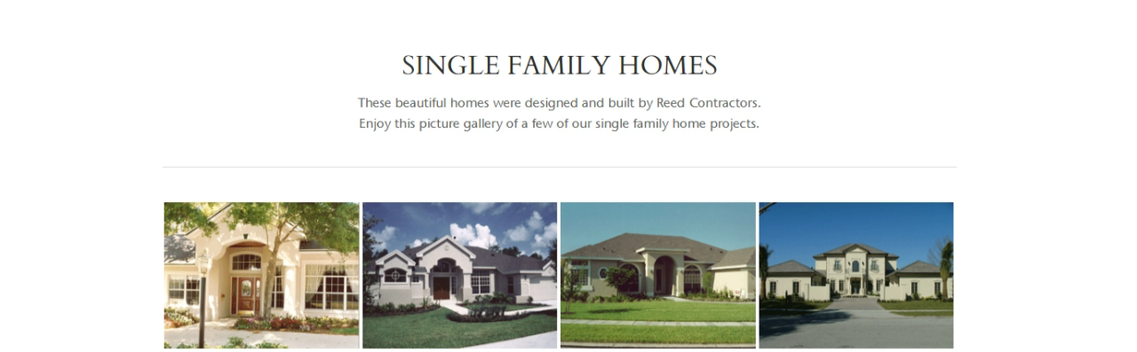
Single Family
Single Family Residences | State of Florida | 31 | $5,067,100 | Development and Construction - general contractor and custom home builder
University Estates | Orlando, FL | 39 |  | Construction - suburban housing community, general contractor
Hawksnest at Metrowest | Orlando, FL | 66 |  | Construction - suburban housing community, general contractor
Eagle Creek | Coral Springs, FL | 77 |  | Construction - suburban housing community, Eagles Trace TPC, general contractor, bank work-out
Hammock Cove | Ponte Vedra, FL | 64 |  | Construction - suburban housing community, Sawgrass TPC, general contractor, bank work-out
TOTAL SINGLE FAMILY |  | 277 | $5,067,100

